Slide 1
The Logic of Experimental Verifiability
Assumptions of Physics collaboration
Notes:
If you, like me, are not satisfied with physical theories that are defined by, essentially, a bunch of math… and you want to know exactly what that math, those Hilbert spaces, those Poisson brackets, actually represent physically, at some point you will realize one thing: you can’t have a proper understanding of these higher level mathematical structures if you don’t understand the lower level structure. You can’t understand space-time if you do not know exactly what point-set topology represents. You can’t understand quantum probability if you do not know exactly what sigma-algebras represent. It’s not enough to have math. We need physically motivated math, math constructed from physical requirement. We need physical mathematics. In this video we are going to do the harder bit: starting. We are going to derive the most fundamental structures we must have in a physical theory starting from requiring experimental verifiability. And while we do that, we will understand how we can, properly, start from physical ideas and, piece by piece, construct a formal system. Construct the math. Ideally, all the math we have in physics should be constructed like that. And it’s not.
We are going to require that a physical theory must at least provide us with a logically consistent set of statements, and it must keep track of which statements are experimentally verifiable. These requirements are formalized into axioms, and from the axioms we go ahead and construct the most basic and general mathematical structures we need for physical theories. At the end of the video, we will discuss a bit how these structure will lead to other structures, like topologies and sigma-algebras, that are the foundations of all other structures, like differential geometry, probability, measure theory, information theory and so on. That is, all these structure are based on the assumption of experimental verifiability, and are therefore not appropriate for things like hidden variables or parallel universe. If you can’t measure it in principle, it can’t have a geometrical structure.
So, let’s see how it all works!

Slide 2
If we wanted to construct an axiomatic theory for all experimental science, what should our primitive notion be?

Slide 3

Principle of scientific objectivity: science is universal, non-contradictory and evidence based.
Guiding principle
Suggest logic as fundamental …
Universal $→$ same for everybody
like mathematics!
Non-contradictory $→$ something is either true or false
Evidence based $→$ truth is determined experimentally
… with some extensions
$⇒$ Logic of experimentally verifiable statements!

Slide 4
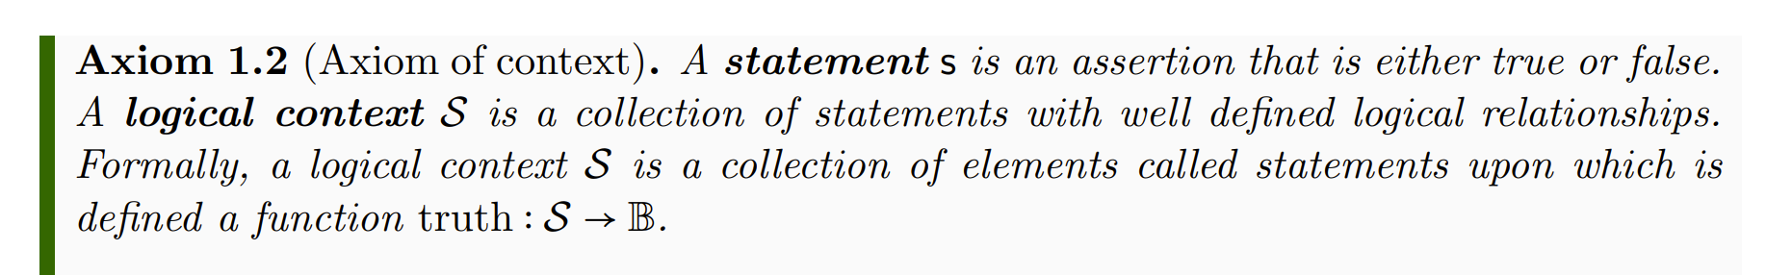
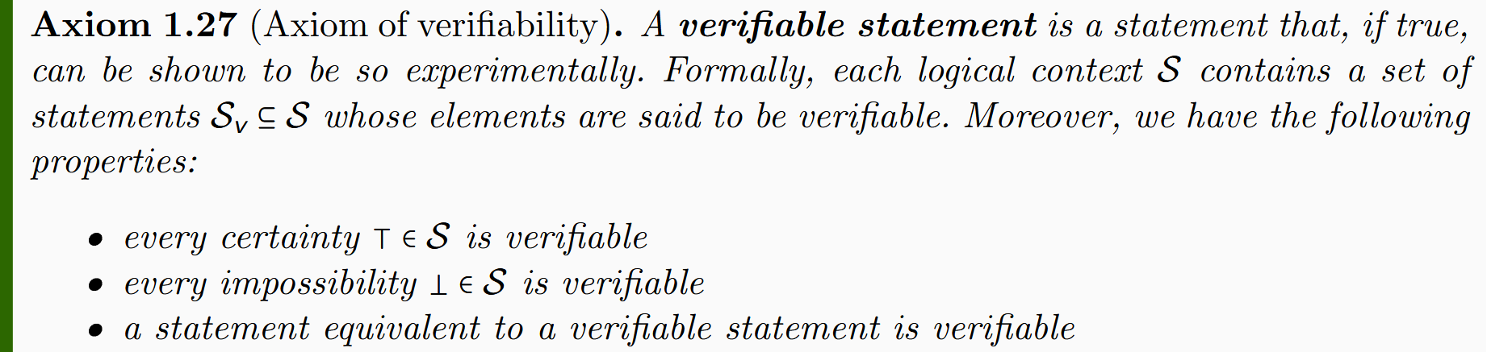
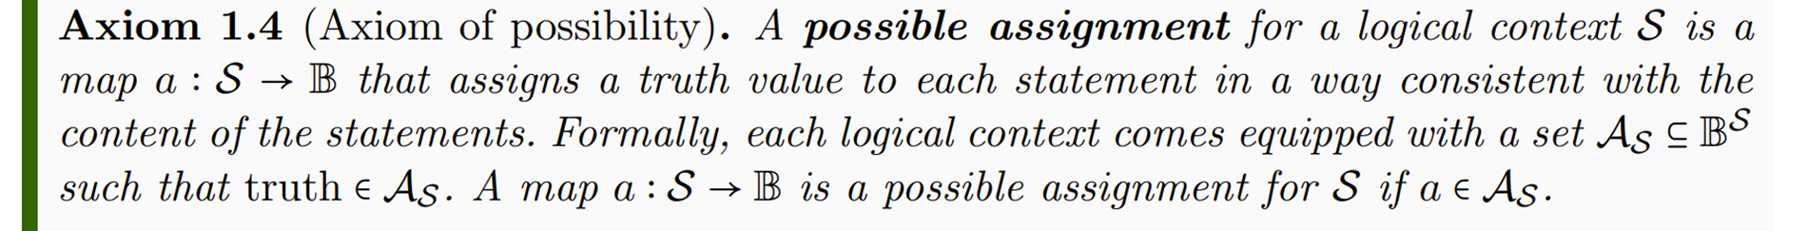
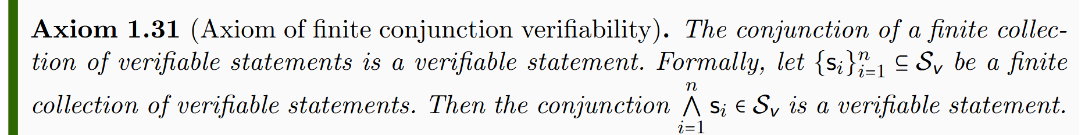
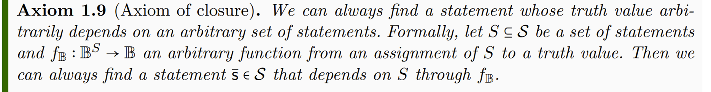
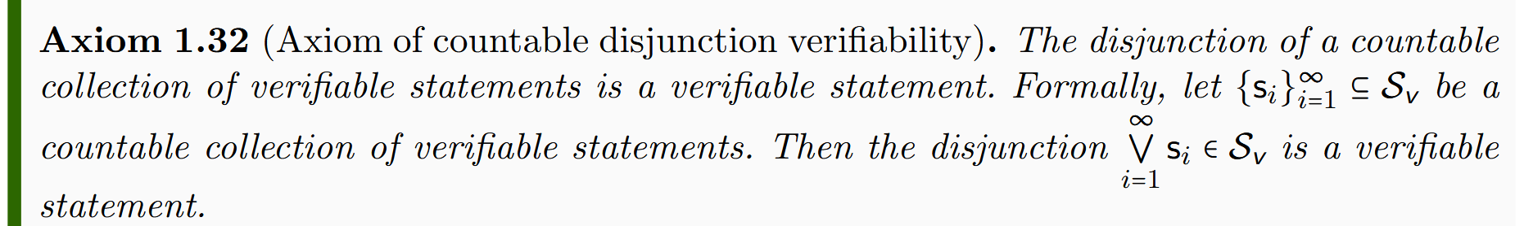
Axioms of logic
Axioms of verifiability
Lead to standard logic (i.e. Boolean algebra)
Lead to intuitionist logic (i.e. Heyting algebra)

Slide 5
Logical context

Slide 6
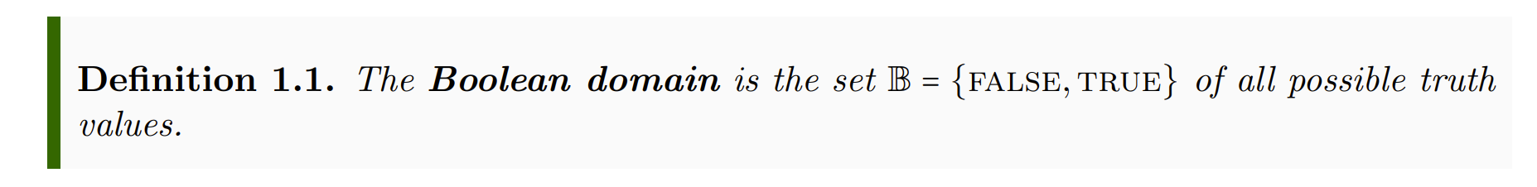
Informal part
Formal part
Informal
Formal
Each axiom/definition has two parts:
Informal part: tells us what elements in the physical world we are characterizing
Formal part: how the elements are characterized mathematically
physics
math
Each axiom/definition has a justification:
argues why the mathematical characterization follows from the physical one

Slide 7
Informal part
Formal part
Informal
Formal
Axiom: brings objects from the informal to the formal
physics
math
Definition: further specializes formal objects
Axioms/definitions should be formulated so that they are easy to justify…
… not so that they follow trends in mathematics

Slide 8

Informal part
Formal part
Informal
Formal
Physical objects are made “mathematically precise” by throwing out everything that can’t be made precise
physics
math
Syntax, grammar, meaning, … can’t be made precise, so are not part of the formal system
$⇒$ Statements are primitive objects

Slide 9
Informal part
Formal part
In mathematics, primitive objects (i.e. those that are left unspecified) must be elements of a set. The logical context, then, has two functions:
1) in the formal system, it is the “container” for the primitive objects (i.e. the statements)
2) in the informal system, consistency/semantics/… are properties of groups of statements (i.e. of the context)

Slide 10
Informal part
Formal part
A statement here represents the assertion and not the sentence that declares the assertion. Therefore the translation of a sentence into another language represents the same statement.
Technically, we only assume the existence of valid statements for doing science. Therefore statements are also primitives in the informal system.
But if they exist, they must follow the axioms we are going to specify.

Slide 11

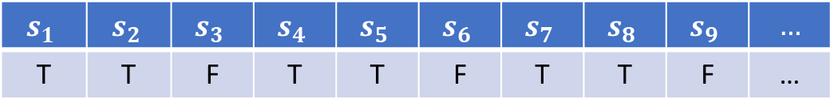

Informal part
Formal part
The existence of a truth function stems from the assumption of non-contradiction and universality.
Every statement must be either true or false for everybody.
$$𝒮$$
$$s_{1}$$ | $$s_{2}$$ | $$s_{3}$$ | $$s_{4}$$ | $$s_{5}$$ | $$s_{6}$$ | $$s_{7}$$ | $$s_{8}$$ | $$s_{9}$$ | $$…$$
T | T | F | T | T | F | T | T | F | …
$$truth$$
Context $⇒$ big table where statements are columns

Slide 12



Example of logical context
The mass of the photon is greater than or equal to $0$ eV
The mass of the photon is less than ${10}^{−13}$ eV
The mass of the photon is greater than or equal to ${10}^{−13}$ eV
The mass of the photon is greater than ${10}^{−13}$ eV
The mass of the photon in eV is a rational number
The mass of the electron is 510 $±$ 0.5 KeV
The mass of the photon is 0 eV or 1 eV
The mass of the photon is exactly 0 eV
The mass of the photon is exactly 1 eV
The mass of the photon is negative

Slide 13
Possible assignments and logical relationships

Slide 14
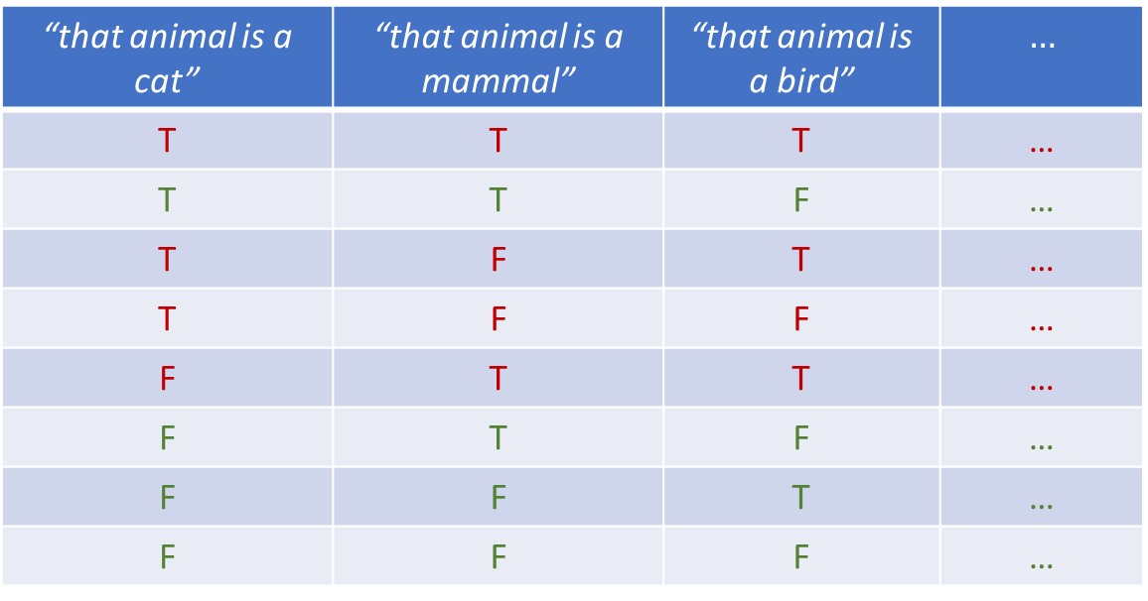
Note: the semantic content constrains the possible combinations of truth values
“that animal is a cat” | “that animal is a mammal” | “that animal is a bird” | $$…$$
T | T | T | …
T | T | F | …
T | F | T | …
T | F | F | …
F | T | T | …
F | T | F | …
F | F | T | …
F | F | F | …
impossible
The only semantics captured by the formal system is the set of possible combinations of truth values
Notes:
Part of the semantic content of the statements is captured by what truth value can be assigned; Possible assignments are determined by the semantic content of the statements

Slide 15
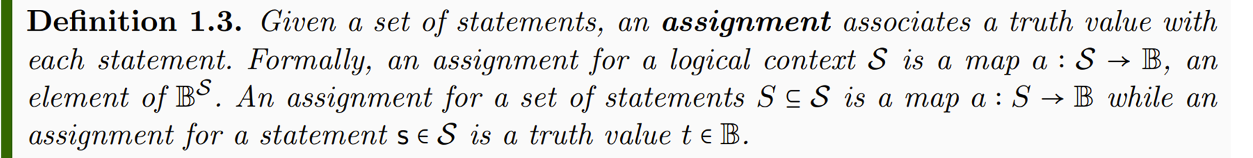


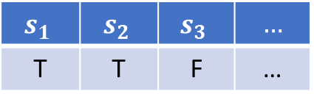

$$s_{1}$$ | $$s_{2}$$ | $$s_{3}$$ | $$…$$
T | T | F | …
$$a$$
assignment for whole context
$a{\left.​\right|}_{\left\{s_{1},s_{2}\right\}}$
$$a(s_{3})$$
assignment for a set of statements
assignment for a single statement

Slide 16


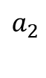

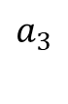


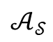
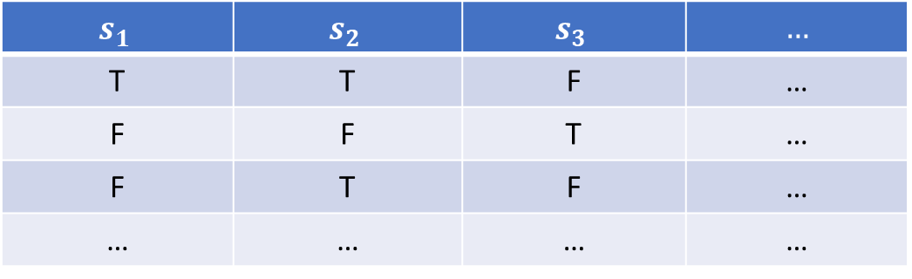
$$s_{1}$$ | $$s_{2}$$ | $$s_{3}$$ | $$…$$
T | T | F | …
F | F | T | …
F | T | F | …
… | … | … | …
$$a_{1}$$
$$truth$$
$$a_{2}$$
$$𝒜_{𝒮}$$
$$a_{3}$$
$$…$$
Possible assignments are those assignments consistent with the meaning (semantics) of the statements
Context $⇒$ big table where statements are columns and possible assignments are rows

Slide 17
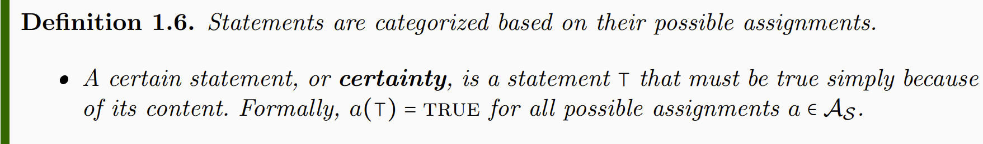
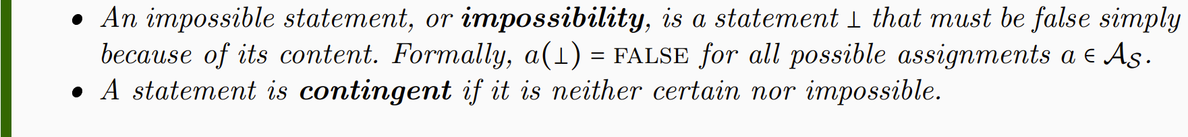
“that cat is a mammal” | “that mammal is a cat” | “that mammal is a bird”
T | T | F
T | F | F
certain
contingent
impossible
Certainties and impossibilities have the same truth value in all rows
Notes:
NOTE: whether a statement is a certainty or not depends on context. Mass of the electron: contingent if measuring the mass, certainty for particle identification

Slide 18

Whether a statement is certain or contingent depends on context!
the mass of the electron is 510 $±$ 0.5 KeV
Contingent when measuring the mass of the electron
Certain when performing
particle identification
Notes:
NOTE: whether a statement is a certainty or not depends on context. Mass of the electron: contingent if measuring the mass, certainty for particle identification

Slide 19
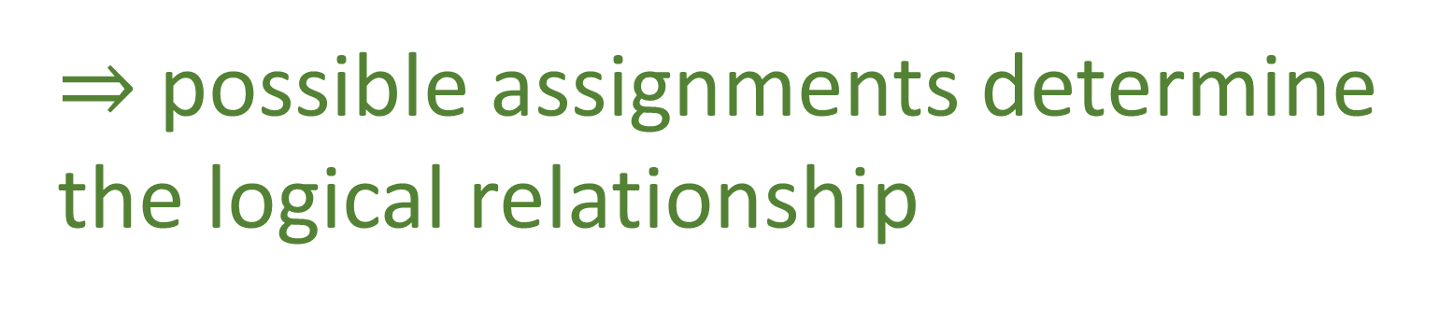
Some statements depend on other statements
That animal is a mammal
That animal has feathers
incompatible
narrower
equivalent
That animal is a cat
That animal is a bird
independent
That animal is black
negation
That animal is not black
$⇒$ possible assignments determine the logical relationship
Notes:
Want to keep track whether the truth of one statement depends on the truth of others: function on truth values – introduce truth tables

Slide 20
Equivalent
Independent
“that animal has feathers” | “that animal is a bird”
T | T
T | F
F | T
F | F
 | T | F
T | ü | û
F | û | ü
“that animal is a cat” | “that animal is black”
T | T
T | F
F | T
F | F
 | T | F
T | ü | ü
F | ü | ü
Incompatible
“that animal is a mammal” | “that animal is a bird”
T | T
T | F
F | T
F | F
 | T | F
T | û | ü
F | ü | ü

Slide 21
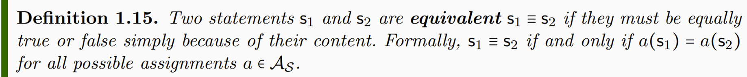
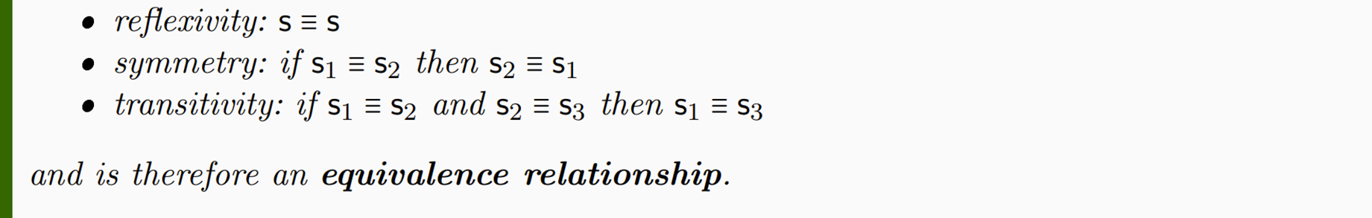

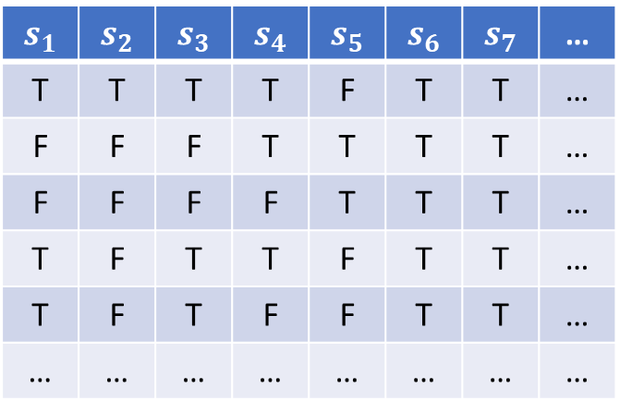
$$s_{1}$$ | $$s_{2}$$ | $$s_{3}$$ | $$s_{4}$$ | $$s_{5}$$ | $$s_{6}$$ | $$s_{7}$$ | …
T | T | T | T | F | T | T | …
F | F | F | T | T | T | T | …
F | F | F | F | T | T | T | …
T | F | T | T | F | T | T | …
T | F | T | F | F | T | T | …
… | … | … | … | … | … | … | …
$$≡$$
$$≡$$
Notes:
Different notion of equivalence Table 1.2

Slide 22
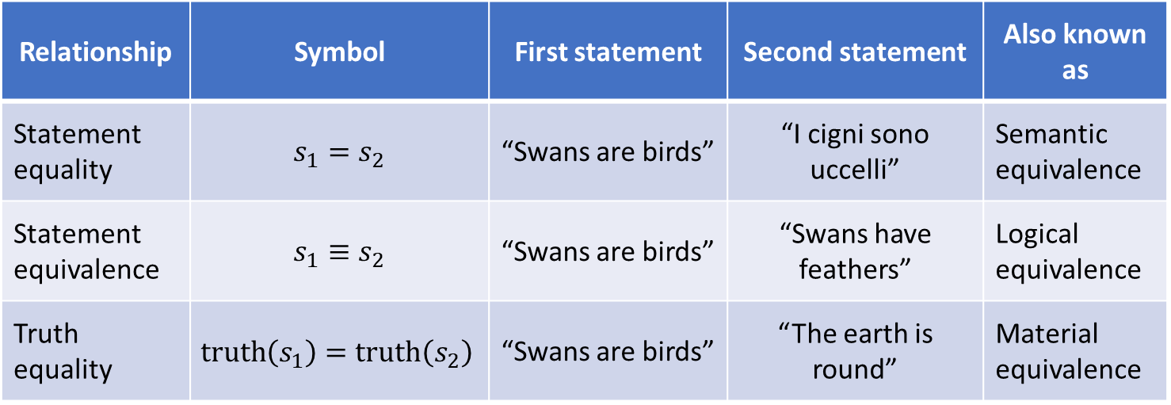
Three types of equivalence relationships among statements
Relationship | Symbol | First statement | Second statement | Also known as
Statement equality | $$s_{1}=s_{2}$$ | “Swans are birds” | “I cigni sono uccelli” | Semantic equivalence
Statement equivalence | $$s_{1}≡s_{2}$$ | “Swans are birds” | “Swans have feathers” | Logical equivalence
Truth equality | $$truth\left(s_{1}\right)=truth\left(s_{2}\right)$$ | “Swans are birds” | “The earth is round” | Material equivalence
We can distinguish between the three cases within the same framework
From now on, if otherwise stated, by statement we mean an equivalence class of statements

Slide 23
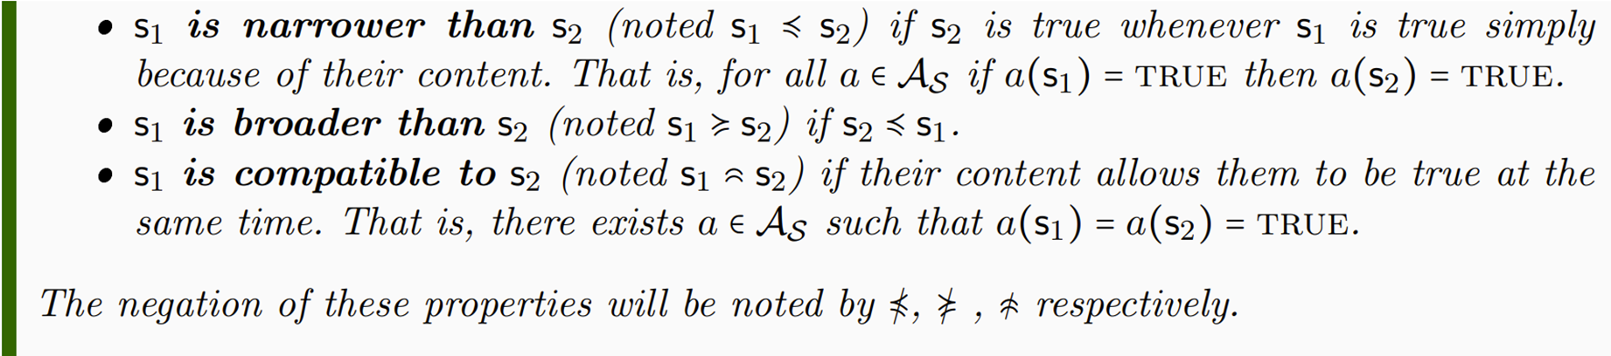

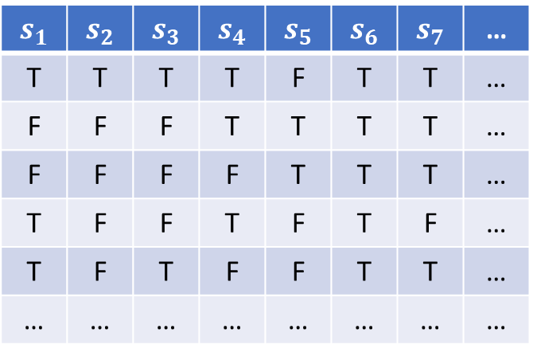

$$s_{1}$$ | $$s_{2}$$ | $$s_{3}$$ | $$s_{4}$$ | $$s_{5}$$ | $$s_{6}$$ | $$s_{7}$$ | …
T | T | T | T | F | T | T | …
F | F | F | T | T | T | T | …
F | F | F | F | T | T | T | …
T | F | F | T | F | T | F | …
T | F | T | F | F | T | T | …
… | … | … | … | … | … | … | …
That animal is a mammal That animal lays eggs
That animal is a cat $≼$ That animal is a mammal
$$≼$$

Slide 24
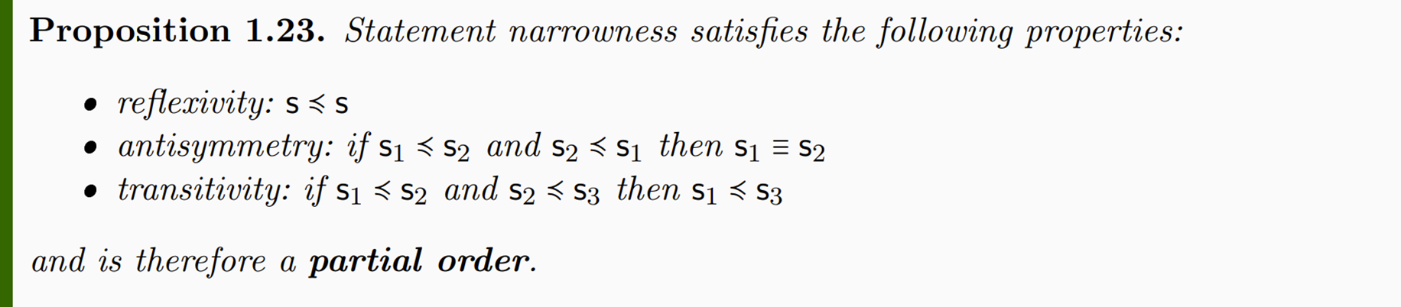

Narrowness $≼$ is related to material implication $→$ but:
Material implication is a logical operation that returns a new statement:
$a→b=¬a∨b$ (i.e. NOT(a) OR b )
Narrowness $≼$ is a binary relationship between statements
The order imposed by narrowness allows us to understand the context as an order theoretic structure

Slide 25















Statements as ordered set
$a=$ “The traffic light is green”
$b=$ “The traffic light is yellow”
broader
$$⊤$$
$c=$ “The traffic light is red”
$x=$ “The traffic light is green or yellow”
$$x$$
$$y$$
$$z$$
$y=$ “The traffic light is green or red”
$$≼$$
$z=$ “The traffic light is red or yellow”
True in more cases
$$a$$
$$b$$
$$c$$
narrower
$$⊥$$

Slide 26
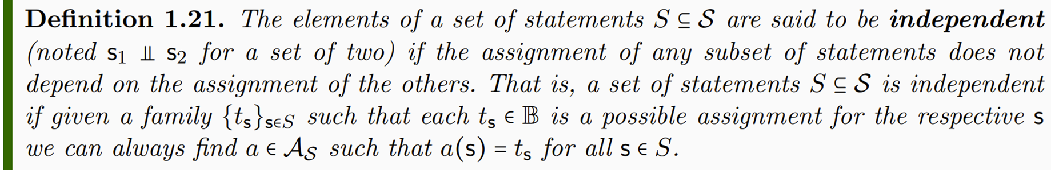
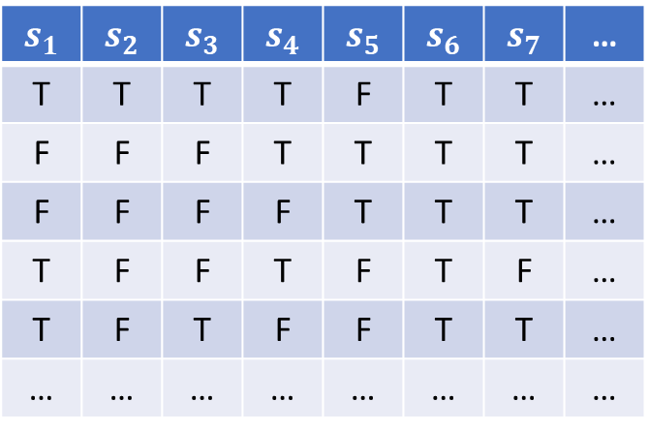

$$s_{1}$$ | $$s_{2}$$ | $$s_{3}$$ | $$s_{4}$$ | $$s_{5}$$ | $$s_{6}$$ | $$s_{7}$$ | …
T | T | T | T | F | T | T | …
F | F | F | T | T | T | T | …
F | F | F | F | T | T | T | …
T | F | F | T | F | T | F | …
T | F | T | F | F | T | T | …
… | … | … | … | … | … | … | …
That animal is a cat That animal is black

Slide 27
Example of logical context
The mass of the photon is greater than or equal to $0$ eV
certainty
The mass of the photon is less than ${10}^{−13}$ eV
The mass of the photon is greater than or equal to ${10}^{−13}$ eV
broader/narrower
The mass of the photon is greater than ${10}^{−13}$ eV
The mass of the photon in eV is a rational number
independent
The mass of the electron is 510 $±$ 0.5 KeV
The mass of the photon is 0 eV or 1 eV
The mass of the photon is exactly 0 eV
The mass of the photon is exactly 1 eV
incompatible
The mass of the photon is negative
impossibility

Slide 28
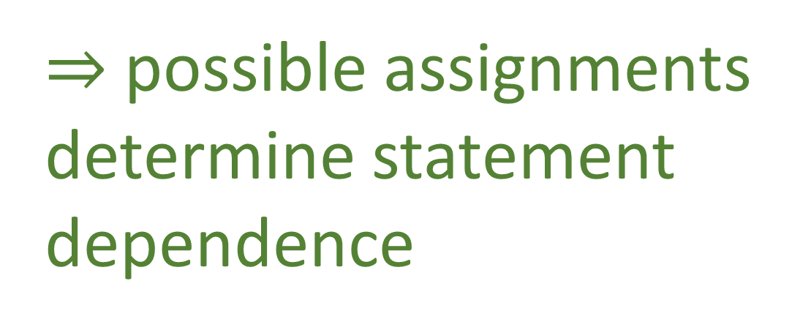

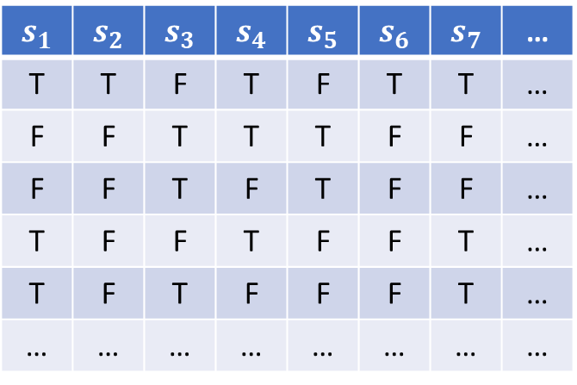
Some statements depend on other statements
That animal is black
negation
That animal is not black
$$s_{1}$$ | $$s_{2}$$ | $$s_{3}$$ | $$s_{4}$$ | $$s_{5}$$ | $$s_{6}$$ | $$s_{7}$$ | …
T | T | F | T | F | T | T | …
F | F | T | T | T | F | F | …
F | F | T | F | T | F | F | …
T | F | F | T | F | F | T | …
T | F | T | F | F | F | T | …
… | … | … | … | … | … | … | …
$⇒$ possible assignments determine statement dependence
$$¬$$
Notes:
Want to keep track whether the truth of one statement depends on the truth of others: function on truth values – introduce truth tables

Slide 29
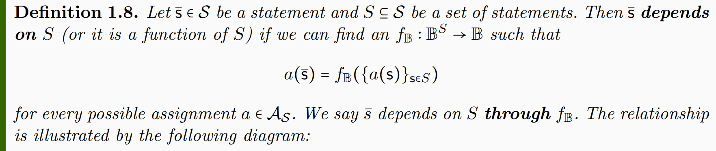










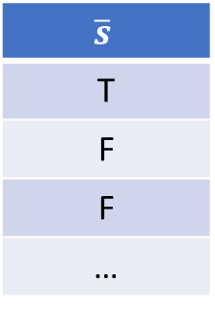



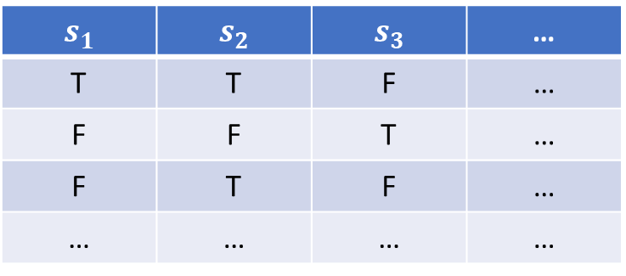


$$s_{1}$$ | $$s_{2}$$ | $$s_{3}$$ | …
T | T | F | …
F | F | T | …
F | T | F | …
… | … | … | …
…
…
…
…
…
$$\overline{s}$$
T
F
F
…
$$a_{1}$$
$a_{1}$($\overline{s})=$ $f_{𝔹}(a_{1}(s_{1})$, $a_{1}(s_{2}$), $a_{1}(s_{3}$))
$$a_{2}$$
$$f_{𝔹}$$
$a_{2}$($\overline{s})$= $f_{𝔹}(a_{2}(s_{1})$, $a_{2}(s_{2}$), $a_{2}(s_{3}$))
$$𝒜_{𝒮}$$
$$a_{3}$$
$s_{1}$ AND ${(s}_{2} OR{ s}_{3})$
$a_{3}$($\overline{s})$= $f_{𝔹}(a_{3}(s_{1})$, $a_{3}(s_{2}$), $a_{3}(s_{3}$))
$$…$$
$f_{𝔹}$(…,…,…)
$$S$$
$s_{1}$=“that animal is a cat”
$s_{2}$=“that animal is a mammal”
$s_{3}$=“that animal is a bird”
Notes:
Applying truth tables to the assignments

Slide 30


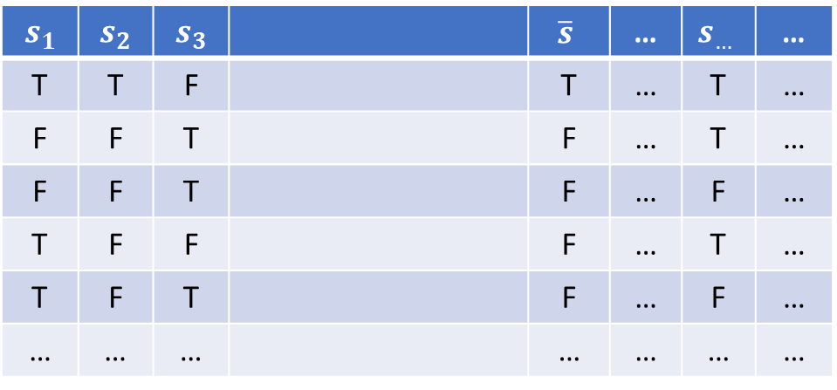
$$s_{1}$$ | $$s_{2}$$ | $$s_{3}$$ |  | $$\overline{s}$$ | … | $$s_{…}$$ | …
T | T | F |  | T | … | T | …
F | F | T |  | F | … | T | …
F | F | T |  | F | … | F | …
T | F | F |  | F | … | T | …
T | F | T |  | F | … | F | …
… | … | … |  | … | … | … | …
Not sure whether it is needed as an axiom: the closure may be proven to exist and be unique.
$$f_{𝔹}$$
$s_{1}$ AND ${(s}_{2} OR{ s}_{3})$
Notes:
The logical context will allows allow all possible truth functions

Slide 31
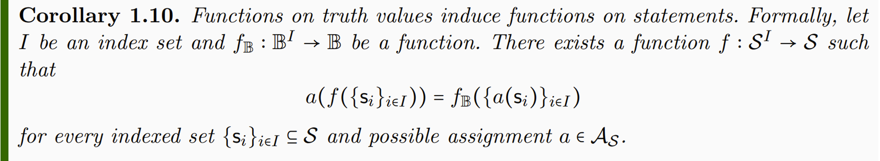

$$f(s_{1},s_{2},s_{3})$$
$$s_{1}$$ | $$s_{2}$$ | $$s_{3}$$ |  | $$\overline{s}$$ | … | $$s_{…}$$ | …
T | T | F |  | T | … | T | …
F | F | T |  | F | … | T | …
F | F | T |  | F | … | F | …
T | F | F |  | F | … | T | …
T | F | T |  | F | … | F | …
… | … | … |  | … | … | … | …
$$f_{𝔹}$$
$s_{1}$ AND ${(s}_{2} OR{ s}_{3})$
Notes:
-> Functions on truth values induce functions on statements

Slide 32
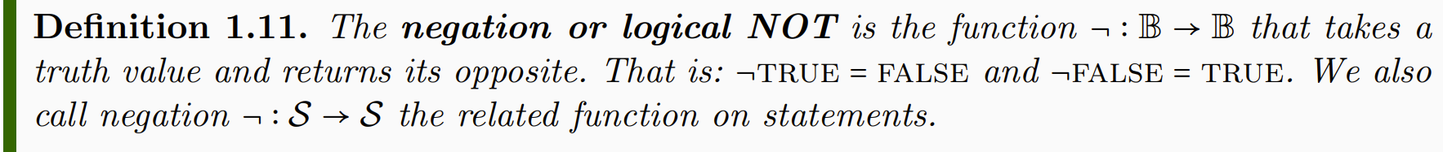


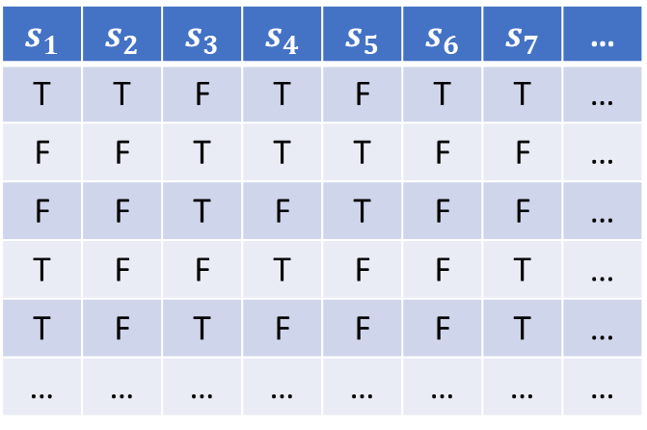
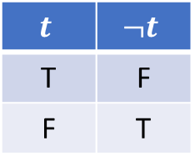
$$t$$ | $$¬t$$
T | F
F | T
$$s_{1}$$ | $$s_{2}$$ | $$s_{3}$$ | $$s_{4}$$ | $$s_{5}$$ | $$s_{6}$$ | $$s_{7}$$ | …
T | T | F | T | F | T | T | …
F | F | T | T | T | F | F | …
F | F | T | F | T | F | F | …
T | F | F | T | F | F | T | …
T | F | T | F | F | F | T | …
… | … | … | … | … | … | … | …
That animal is a cat
$$¬$$
That animal is not a cat
$$¬$$

Slide 33
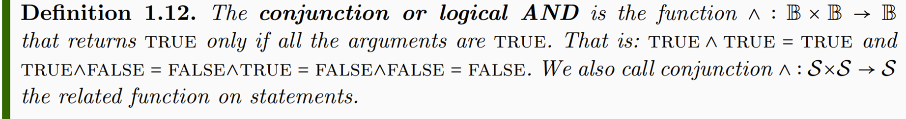
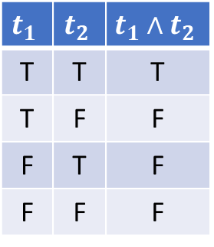


$$t_{1}$$ | $$t_{2}$$ | $$t_{1}∧t_{2}$$
T | T | T
T | F | F
F | T | F
F | F | F
$$s_{1}$$ | $$s_{2}$$ | $$s_{3}$$ | $$s_{4}$$ | $$s_{5}$$ | $$s_{6}$$ | $$s_{7}$$ | …
T | T | F | T | F | T | T | …
F | F | T | T | T | F | F | …
F | F | T | F | T | F | F | …
T | F | F | T | F | F | T | …
T | F | T | F | F | F | T | …
… | … | … | … | … | … | … | …
That animal is a cat
That animal is black
$$∧$$
That animal is a black cat
$$∧$$

Slide 34
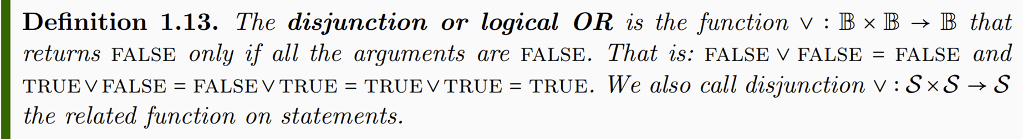
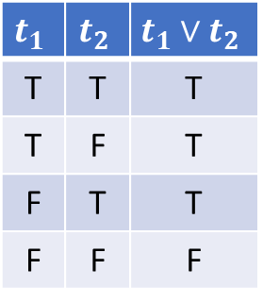


$$t_{1}$$ | $$t_{2}$$ | $$t_{1}∨t_{2}$$
T | T | T
T | F | T
F | T | T
F | F | F
$$s_{1}$$ | $$s_{2}$$ | $$s_{3}$$ | $$s_{4}$$ | $$s_{5}$$ | $$s_{6}$$ | $$s_{7}$$ | …
T | T | F | T | F | T | T | …
F | F | T | T | T | F | F | …
F | F | T | F | T | F | F | …
T | F | F | T | F | F | T | …
T | F | T | F | F | F | T | …
… | … | … | … | … | … | … | …
That animal is a cat
That animal is a dog
$$∨$$
That animal is a cat or a dog
$$∨$$

Slide 35

NOTE: AND, OR and NOT ($∧, ∨,¬$) are operations within the context: they return other statements
Equivalence, narrowness, compatibility, … ($≡,≼, ,…)$
are not: they describe the context (i.e. metalanguage)

Slide 36
Example of logical context
The mass of the photon is greater than or equal to $0$ eV
certainty
The mass of the photon is less than ${10}^{−13}$ eV
negation
The mass of the photon is greater than or equal to ${10}^{−13}$ eV
broader/narrower
The mass of the photon is greater than ${10}^{−13}$ eV
The mass of the photon in eV is a rational number
independent
The mass of the electron is 510 $±$ 0.5 KeV
The mass of the photon is 0 eV or 1 eV
disjunction
The mass of the photon is exactly 0 eV
The mass of the photon is exactly 1 eV
incompatible
The mass of the photon is negative
impossibility

Slide 37
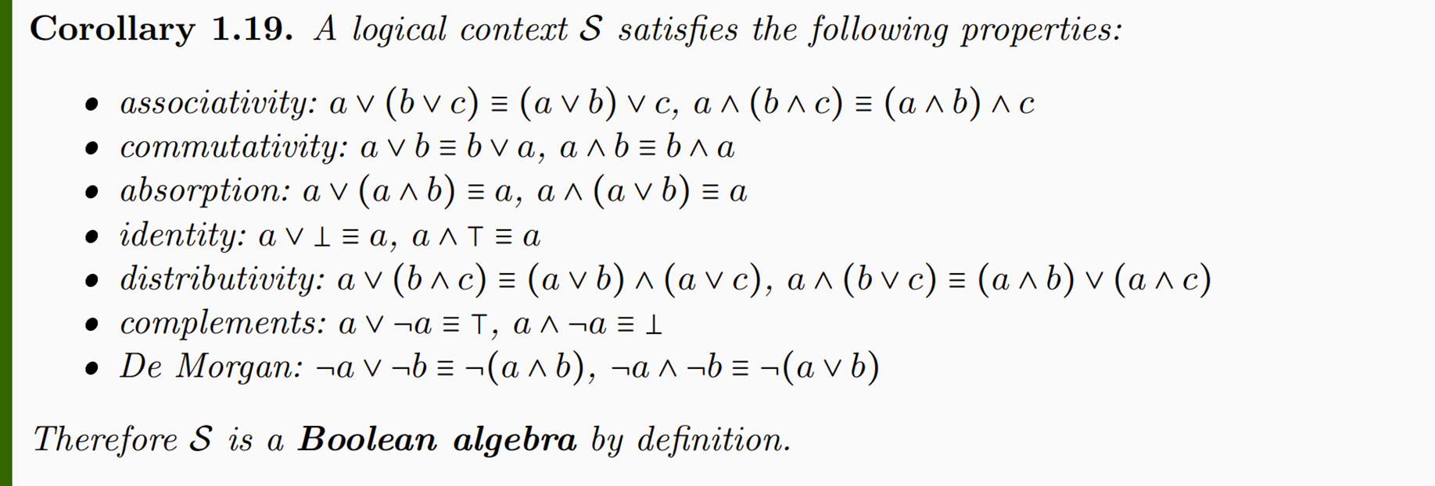
Recovers the standard structure for classical logic
Note how many properties are part of the definition of a Boolean algebra: if that had been our starting point, we would have had to justify every single one, which is cumbersome and not particularly enlightening

Slide 38
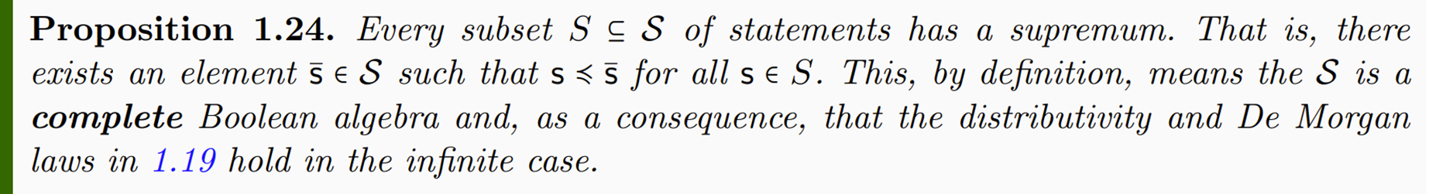
A logical context is a complete lattice
This means that all properties generalize to the infinite case

Slide 39
Three ways to look at the logical context
Truth table: columns $→$ statements; rows $→$possible assignments
Most direct way to relate to logic
Algebra: set of elements together with some operations $\left(∧,∨,¬\right)$
Geometry, probability, measure theory related to this view
Partially ordered set (POSET): ordered set of elements $\left(≼\right)$
System composition/decoupling, ordered structures related to this view

Slide 40














Statements as algebra/lattice
$a=$ “The traffic light is green”
$b=$ “The traffic light is yellow”
broader
$$⊤=x∨y=y∨z=x∨z=a∨b∨c$$
$c=$ “The traffic light is red”
AND $∧$ OR $∨$
NOT $¬$
$$x=a∨b$$
$$y=a∨c$$
$$z=b∨c$$
narrower/broader
$$≼$$
True in more cases
$$supremum\left(\left\{q,p\right\}\right)⇒q∨p$$
$$q∨p=p⇒q≼p$$
$$a=x∧y$$
$$b=x∧z$$
$$c=y∧z$$
$$infimum\left(\left\{q,p\right\}\right)⇒q∧p$$
$$q∧p=q⇒q≼p$$
narrower
$$⊥=a∧b=b∧c=a∧c=x∧y∧z$$

Slide 41

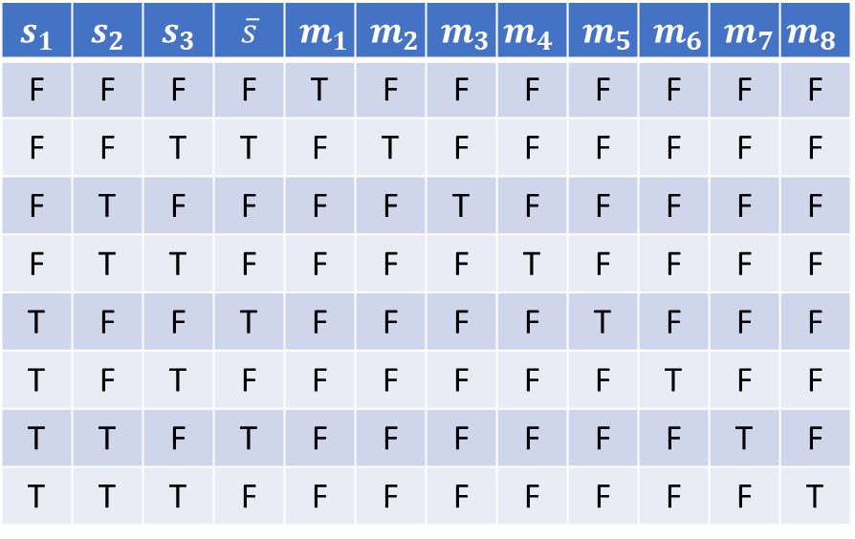



Functions in a Boolean algebra have a standard representation important for us
$$s_{1}$$ | $$s_{2}$$ | $$s_{3}$$ | $$\overline{s}$$ | $$m_{1}$$ | $$m_{2}$$ | $$m_{3}$$ | $$m_{4}$$ | $$m_{5}$$ | $$m_{6}$$ | $$m_{7}$$ | $$m_{8}$$
F | F | F | F | T | F | F | F | F | F | F | F
F | F | T | T | F | T | F | F | F | F | F | F
F | T | F | F | F | F | T | F | F | F | F | F
F | T | T | F | F | F | F | T | F | F | F | F
T | F | F | T | F | F | F | F | T | F | F | F
T | F | T | F | F | F | F | F | F | T | F | F
T | T | F | T | F | F | F | F | F | F | T | F
T | T | T | F | F | F | F | F | F | F | F | T
$m_{i}$ each picks a line of the table, and can be expressed as the conjunction that takes $s_{1},s_{2},s_{3}$ once, negated or not
$m_{1}=¬s_{1}∧¬s_{2}∧¬s_{3}$
$m_{2}=¬s_{1}∧¬s_{2}∧s_{3}$
$m_{3}=¬s_{1}∧s_{2}∧¬s_{3}$
$m_{4}=¬s_{1}∧s_{2}∧s_{3}$ $m_{5}=s_{1}∧¬s_{2}∧¬s_{3}$
$m_{6}=s_{1}∧¬s_{2}∧s_{3}$
$m_{7}=s_{1}∧s_{2}∧¬s_{3}$
$m_{8}=s_{1}∧s_{2}∧s_{3}$
minterms
$\overline{s}$ is a function of $s_{1},s_{2},s_{3}$
$\overline{s}$ is the disjunction of $m_{2},m_{5},m_{7}$
$$\overline{s}=\left(¬s_{1}∧¬s_{2}∧s_{3}\right)∨\left(s_{1}∧¬s_{2}∧¬s_{3}\right)∨\left(s_{1}∧s_{2}∧¬s_{3}\right)$$
disjunctive normal form

Slide 42
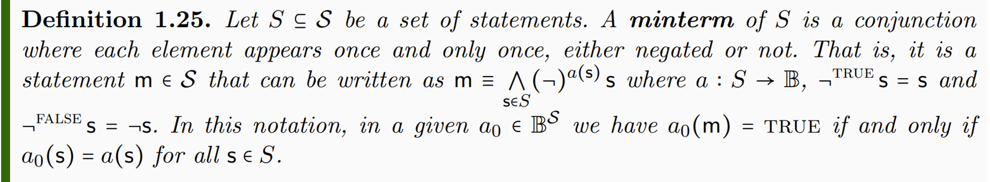
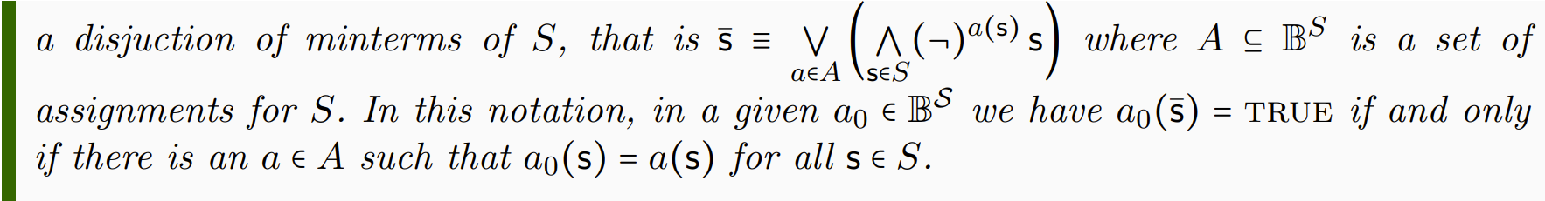
Formally

Slide 43
Example of logical context
The mass of the photon is greater than or equal to $0$ eV
certainty
The mass of the photon is less than ${10}^{−13}$ eV
negation
The mass of the photon is greater than or equal to ${10}^{−13}$ eV
broader/narrower
The mass of the photon is greater than ${10}^{−13}$ eV
The mass of the photon in eV is a rational number
independent
The mass of the electron is 510 $±$ 0.5 KeV
The mass of the photon is 0 eV or 1 eV
disjunction
The mass of the photon is exactly 0 eV
The mass of the photon is exactly 1 eV
incompatible
The mass of the photon is negative
impossibility

Slide 44
Verifiable statements

Slide 45

Not “verifiable statements”
Chocolate tastes good (not universal)
It is immoral to kill one person to save ten (not universal and/or evidence based)
The number 4 is prime (not evidence based)
This statement is false (not non-contradictory)
The mass of the photon is exactly $0$ eV (not verifiable due to infinite precision)
“Verifiable statements”
The mass of the photon is less than ${10}^{−13}$ eV
If the height of the mercury column is between 24 and 25 millimeters then its temperature is between 24 and 25 Celsius
If I take $2±0.01$ Kg of Sodium-24 and wait $15±0.01$ hours there will be only $1±0.01$ Kg left
A scientific theory needs “at least” the concept of a verifiable statement: good primitive notion

Slide 46
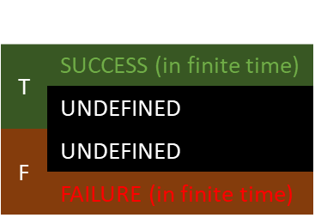
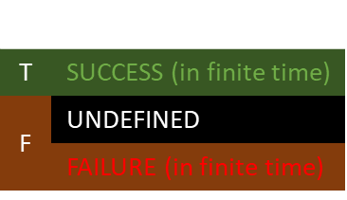
New axiom to bring in the idea that some statements are experimentally verifiable
statement
experimental test
Statements are verifiable if there is a test that always terminates successfully if the statement is true
$$s$$ | $$e$$
T | SUCCESS (in finite time)
 | UNDEFINED
F | UNDEFINED
 | FAILURE (in finite time)
$$s$$ | $$e$$
T | SUCCESS (in finite time)
F | UNDEFINED
 | FAILURE (in finite time)
Tests may or may not terminate

Slide 47
The tests are not objects in the mathematical framework
Defining tests formally is cumbersome
Capturing which statements are verifiable is enough
Formally we are only “tagging” which statements are verifiable
Only need to tag the verifiable statements: test termination for all other statements can be determined from their logical relationship

Slide 48
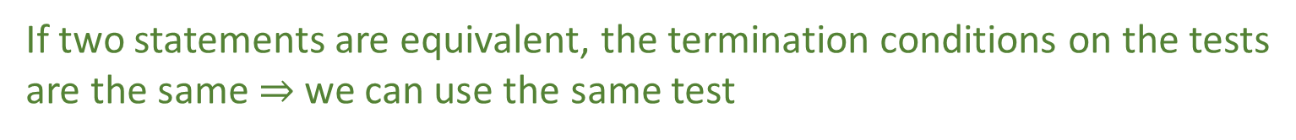
Certainties and impossibilities are defined to be true and false, therefore a trivial test that always succeeds or fails is adequate
If two statements are equivalent, the termination conditions on the tests are the same $⇒$ we can use the same test

Slide 49
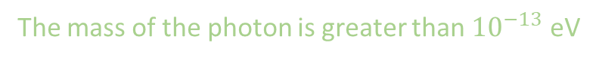


Example of logical context
verifiable statement
The mass of the photon is greater than or equal to $0$ eV
certainty
The mass of the photon is less than ${10}^{−13}$ eV
negation
The mass of the photon is greater than or equal to ${10}^{−13}$ eV
broader/narrower
The mass of the photon is greater than ${10}^{−13}$ eV
The mass of the photon in eV is a rational number
independent
The mass of the electron is 510 $±$ 0.5 KeV
The mass of the photon is 0 eV or 1 eV
disjunction
The mass of the photon is exactly 0 eV
The mass of the photon is exactly 1 eV
incompatible
The mass of the photon is negative
impossibility

Slide 50





$$s$$ | $$e$$
T | SUCCESS (in finite time)
F | UNDEFINED
 | FAILURE (in finite time)
$$¬s$$ | $$e_{¬}(e)$$
T | SUCCESS (in finite time)
 | UNDEFINED
F | FAILURE (in finite time)
$e_{¬}(e)$:
Run test $e$
If $e$ fails, return SUCCESS
If $e$ succeeds, return FAILURE
From $e$, we can construct the test $e_{¬}(e)$ that switches SUCCESS with FAILURE,
but the non-termination remains
$⇒$ the logic of verifiable statements does not include negation!

Slide 51


$$s$$ | $$e$$
T | SUCCESS (in finite time)
 | UNDEFINED
F | FAILURE (in finite time)
Statements are falsifiable if there is a test that always terminates with failure if the statement is true
Note that formally falsifiable is defined to be the negation of verifiable statements
Reduces the number of primitive concepts
$⇒$ The justification must show these definitions to be equivalent

Slide 52





Suppose $¬s$ is verifiable. Then we can find a test such that
From $e$, we can construct the test $e_{¬}(e)$ that switches SUCCESS with FAILURE
$e_{¬}(e)$:
Run test $e$
If $e$ fails, return SUCCESS
If $e$ succeeds, return FAILURE
$$s$$ | $$¬s$$ | $$e$$ | $$e_{¬}(e)$$
T | F | FAILURE (in finite time) | SUCCESS (in finite time)
 |  | UNDEFINED | UNDEFINED
F | T | SUCCESS (in finite time) | FAILURE (in finite time)
$⇒$ If the negation of a statement is verifiable, then the statement is falsifiable

Slide 53


$$s$$ | $$e$$
T | SUCCESS (in finite time)
F | FAILURE (in finite time)
Statements are decidable if there is a test that always terminates
Note that formally decidable statements are verifiable statements whose negation is verifiable
$⇒$ The justification must show these definitions to be equivalent

Slide 54






Construct the test $\hat{e}(e, e_{¬})$
Suppose $s$ is verifiable. Then we can find a test such that
$\hat{e}(e, e_{¬})$:
Initialize $n$ to 1
Run $e$ for $n$ seconds
If $e$ succeeds, return SUCCESS
Run $e_{¬}$for $n$ seconds
If $e_{¬}$ succeeds, return FAILURE
Increment $n$ and go to 2
$$s$$ | $$¬s$$ | $$e$$ | $$e_{¬}$$ | $$\hat{e}(e, e_{¬})$$
T | F | SUCCESS (in finite time) | FAILURE (in finite time) | SUCCESS (in finite time)
 |  |  | UNDEFINED
F | T | UNDEFINED | SUCCESS (in finite time) | FAILURE (in finite time)
 |  | FAILURE (in finite time) | SUCCESS (in finite time) | FAILURE (in finite time)
Suppose $¬s$ is verifiable. Then we can find a test such that
$⇒$ If $s$ and $¬s$ verifiable, then the statement is decidable

Slide 55


Certainties and impossibilities are true and false by definition. We can make trivial tests for them.
$e_{⊤}$:
return SUCCESS
$e_{⊥}$:
return FAILURE

Slide 56

Conjunction (AND) of verifiable statements: check that all tests terminate successfully
$∧(e_{i})$:
Run all $e_{i}$
If all succeed, return SUCCESS
Return FAILURE
$⇒$ Only finite conjunction is guaranteed to terminate

Slide 57


Disjunction (OR) of verifiable statements: check that ONE test terminates successfully
$∨(e_{i})$:
Initialize $n$ to 1
For each $i=1…n$
Run $e_{i}$ for $n$ seconds
If $e_{i}$ succeeds, return SUCCESS
Increment $n$ and go to 2
watch out for non-termination!
$⇒$ Only countable disjunction can reach all tests

Slide 58



For decidable statements, we need both the statement and its negation to be verifiable
$¬ \bigwedge{e_{i}}=\bigvee{¬e_{i}}$
$¬\bigvee{e_{i}}= \bigwedge{¬e_{i}}$
Using De Morgan properties, we can construct tests using test for negations

Slide 59




Comparing algebras
$$𝒮_{d}$$
$$𝒮_{v}$$
$$𝒮$$

Slide 60
Experimental domain

Slide 61



What is the largest set of verifiable statements it makes sense to consider?
$$s_{1},s_{2},s_{3},…, s_{n}, …$$
Note: even assuming an indeterminate amount of time, we can only run up to countably many tests
$$s_{1}∨s_{2},s_{1}∧s_{2}, …$$
However, testing those statements implicitly tests all other statements that depend on those
$⇒$ Set of verifiable statements whose truth can be verified by running countably many tests

Slide 62





$$𝒟$$
$$ℬ=\{e_{1},e_{2},e_{3},…\}$$
$$ℬ$$
Only finite conjunction and countable disjunction
$$s_{1}=\left(e_{1}∨e_{3}\right)∧e_{2}…$$

Slide 63
$$𝒟$$
$$ℬ=\{e_{1},e_{2},e_{3},…\}$$
$$ℬ$$
Countable basis
Only finite conjunction and countable disjunction
$$s_{1}=\left(e_{1}∨e_{3}\right)∧e_{2}…$$

Slide 64
Every physical theory must be fully characterized by an experimental domain
All its content must be expressible in terms of verifiable statements
The theory must be fully explorable with a countable set of tests

Slide 65



$$𝒮$$
logical context
A physical theory establishes logical dependencies between experimental domains
$$𝒮_{v}$$
verifiable statements
$$𝒟$$
experimental domains
particle state
position
velocity
energy
time

